Slide 1

WebBuilder
Leading the New Era of AI-Driven Enterprise Application Development
Geejing Technology
Notes:
Hello everyone, welcome to today's sharing. As the digital wave sweeps across the globe, enterprise application development is facing unprecedented challenges and opportunities. Today, I will introduce to you a revolutionary product—WebBuilder, which will lead us into a new era of AI-driven enterprise application development.

Slide 2

CONTENTS
01
Company Introduction
An outstanding provider of enterprise-level application system development solutions, focusing on creating efficient and intelligent development tools.
05
Competitive Analysis
In-depth comparison of WebBuilder's advantages and core differences with competitors like WorkBuddy and bolt AI.
02
Product Introduction
A revolutionary enterprise-level application development and runtime platform, deeply integrating low-code and AI to reshape the development experience.
06
Case Studies
Successful implementation cases and practical application effects of WebBuilder in finance, manufacturing, retail and other industries.
03
Core Value Proposition
In-depth elaboration on the core values WebBuilder brings to enterprises, including efficiency improvement, cost reduction, quality assurance, and system scalability.
07
Our Clients
Leading enterprises and partners from various industries, jointly witnessing the stability and reliability of the product.
04
Core Function Details
In-depth analysis of WebBuilder's core capabilities such as AI intelligent generation, visual orchestration, and automated deployment.
08
Summary and Outlook
Review the core value of the product, look forward to the future development blueprint, and open a new chapter in enterprise application development.
Notes:
This presentation will be divided into eight parts. First, we will get to know Techview, the creator of WebBuilder. Next, I will elaborate on the core values and key features of the WebBuilder product. Then, we will dive deep into its core value proposition and powerful AI capabilities. After that, a comparative analysis will be conducted against other AI tools available on the market. Finally, we will demonstrate the outstanding performance of WebBuilder through real‑world cases and customer testimonials, followed by an outlook for the future.

Slide 3
01 Company Introduction
An Outstanding Provider of Enterprise Application System Development Solutions
Technology-Driven Innovation
Full-Stack Solutions
Value Delivery Commitment
Committed to independent research and development, breaking through technological bottlenecks, and empowering digital transformation with cutting-edge technology.
Covering demand analysis, design, development, testing, and operation and maintenance, providing a one-stop digital transformation service.
Customer-centric, providing high-quality services and solutions to help customers achieve sustainable growth and success.
"Committed to technological innovation, empowering the future of enterprises, and building a trustworthy digital partner."
Notes:
First, let's get to know the creator of WebBuilder – Geejing. Geejing is a provider of enterprise application system development solutions, dedicated to helping enterprises achieve efficient and high-quality information construction through outstanding technologies and products.

Slide 4
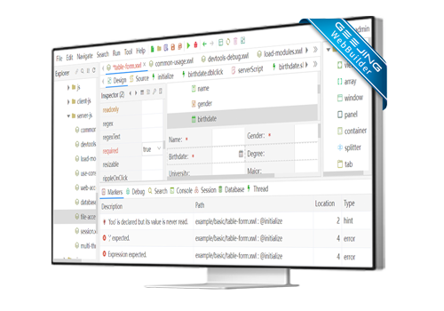
Company Overview
Geejing is a provider focused on enterprise-level application system development solutions. Relying on profound technical heritage and rich application development experience, we are committed to helping users carry out efficient and high-quality informatization construction.
Precise Positioning - Solution Expert
Committed to providing professional, comprehensive and high-quality solutions to help enterprises achieve digital transformation.
Core Strength - Driven by Technology and Experience
With profound technical accumulation and rich practical experience, we ensure the stability, high efficiency and scalability of the system.
Empowering Enterprise Digital Takeoff with Technology
Notes:
Geejing's positioning is very clear: to be an outstanding provider of enterprise-level application system development solutions. With profound technical accumulation and rich practical experience, we are always focused on helping customers improve their digitalization level and complete the important task of informatization construction. Our mission is to make technology truly serve enterprise development.

Slide 5
Business Objectives
We always adhere to providing professional and ultimate products, enabling more users to enjoy the convenience brought by technological progress. Through continuous efforts to create excellent products and services, we will bring the speed of technology to every user and build a better digital life.
Product Philosophy
Core Goal
Adhere to the core concept of "excellence" and "professionalism", keep improving product quality, use professional technology and meticulous service to create value for users, and make every interaction a perfect experience, creating a unique brand taste.
Adhere to technological innovation, break through technical boundaries, provide customers with the best product solutions, strive to become the industry benchmark, create sustainable value for customers, and achieve a win-win situation between customer needs and enterprise development.
—— Focus on technological innovation, empower a better life ——
Notes:
Our business objective is to create better products, provide more professional technology and more meticulous services through continuous innovation. We firmly believe that only by constantly pursuing excellence can more users enjoy the real convenience brought by technological progress.

Slide 6
Customer First
We always adhere to the core value of customer-centricity, respond quickly to customer needs with a sincere attitude, provide professional technical support and services, help customers improve their system construction capabilities, effectively reduce their investment and operation costs, create sustainable long-term value for customers, and ultimately achieve common growth and win-win results with customers.
Service Tenet: Rapid Response
Customer Value: Cost Reduction and Efficiency Improvement
Establish a perfect service system, respond to customer needs in a timely manner, provide professional solutions with a sincere attitude, and let customers enjoy worry-free after-sales service.
Help customers reduce development costs, improve their own R&D capabilities, quickly respond to market changes, realize the optimization of business processes, and achieve the dual improvement of economic benefits and operational efficiency.
"Customer-oriented, value-creation-focused, and achieving customers means achieving ourselves."
Notes:
Customer First is our unwavering tenet. We are committed to responding quickly to every customer need, helping customers enhance their system construction capabilities and reduce construction costs through our products and services, ultimately creating long-term value and growing together with our customers.

Slide 7
Corporate Vision
"Striving for ultimate products to make informatization construction simple and beautiful."
Technical Pursuit
Ultimate Vision
Deeply cultivate core technologies, continue to innovate, empower technological upgrading with cutting-edge technology, build a reliable technical foundation for the stable operation of the enterprise, and empower the digital transformation of the industry.
Committed to simplifying processes and reducing complexity, making complex informatization construction easy and fast, creating a better digital future for enterprises, and realizing the unity of enterprise value and social value.
Notes:
Our vision is to create ultimate products through superior technology, and ultimately make complex informatization construction simple and beautiful. This is not only our goal, but also the driving force for our struggle.

Slide 8
02 Product Introduction
A Revolutionary Enterprise Application Development and Runtime Platform
Rapid Low-Code Development
Enterprise-Grade Security Architecture
High-Availability Elastic Architecture
Automate tedious development processes, open up the entire link from code generation to operation and maintenance, and significantly reduce development costs.
Built-in multi-dimensional security system, supporting fine-grained permission control, ensuring data security at all levels, and escorting enterprise core business.
Based on a microservice-oriented architecture design, supporting flexible expansion and contraction of resources, adapting to business scenarios from small and medium-sized enterprises to large-scale enterprises.
"Break down traditional development barriers, empower business innovation with technology, and build a stable, efficient, and secure digital foundation for enterprises."
Notes:
Next, let's officially introduce today's protagonist—WebBuilder. It's not just a tool, but a revolutionary enterprise application development and runtime platform that will completely change the way we develop applications.

Slide 9
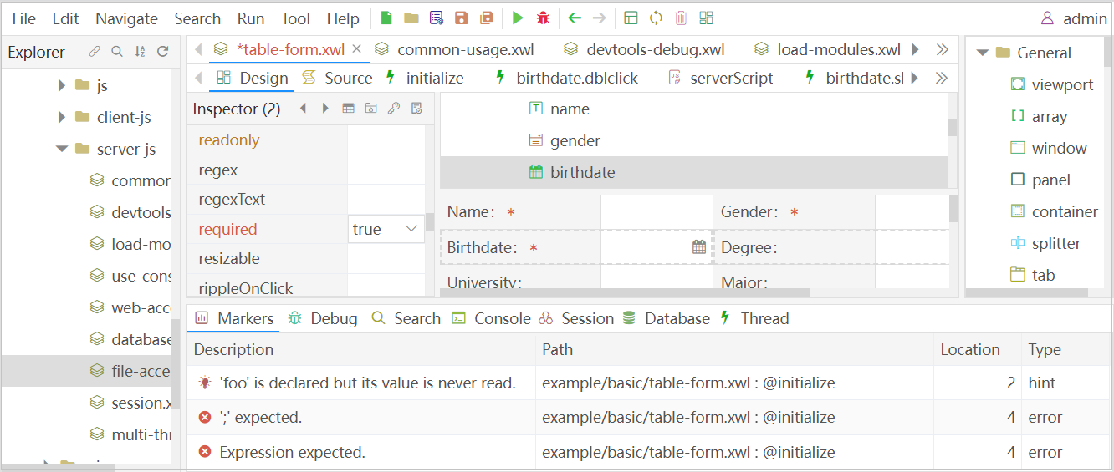
What is WebBuilder?
WebBuilder is an integrated development environment (IDE) based on a browser, specially designed for enterprise-level application development. It features visualized design, high-speed compilation and rapid operation, and is stable and scalable, making it very suitable for the development and operation of complex enterprise-level applications.
Core Position
Excellent Features
Enterprise-level application development and runtime platform, providing a one-stop solution.
Powerful, comprehensive, efficient, stable and scalable, easy to develop and deploy.
Cloud IDE
Multi-Terminal Adaptation
Browser-based, accessible anytime, anywhere, no local installation required.
Automatically adapts to desktops, mobile devices and enterprise application scenarios.
Visual development interface, making application building simple and efficient
Notes:
So, what exactly is WebBuilder? Simply put, it is a powerful, comprehensive, and efficient application development and runtime platform. Its IDE is browser-based, allowing you to develop anytime, anywhere. Whether it's desktop applications, mobile applications, or complex enterprise-level applications, WebBuilder can handle them all with ease.

Slide 10
Core Value Proposition
WebBuilder is committed to providing developers with an unparalleled development experience, greatly improving the development efficiency and quality of application systems, making technological innovation and business iteration faster and more agile.
Improve Development Efficiency
Ensure Application Quality
Significantly shorten the development cycle through intelligent generation and low-code tools, realize rapid iteration from project launch to online, and improve development efficiency.
Ensure the stability and reliability of the application from the source through standardized development processes and high-quality code generation, and enhance the system's resistance to risks and maintainability.
Reduce Development Costs
Enhance System Scalability
Reduce repetitive work, lower the skill requirements for developers, optimize human resource allocation, and effectively control the overall cost of development and maintenance.
The modular architecture design supports flexible functional expansion and customized development, meeting the long-term development needs of the enterprise.
Notes:
The core value of WebBuilder lies in delivering a revolutionary experience for developers. It significantly boosts development efficiency through intelligent tools and automated workflows; ensures application quality via standardized processes and high‑quality code; meanwhile, it effectively cuts development costs and enhances system scalability with its modular architecture.

Slide 11
Core Functional Modules
Powerful Development Environment
AI Intelligent Generation
Full-Stack Automatic Adaptation
Built-in intelligent editor and real-time debugging tools, supporting multi-language mixed development and intelligent code completion, making development easier and more efficient.
Based on deep learning to intelligently generate standardized business modules and code content, reducing repetitive development work, allowing developers to focus on core business logic and innovation.
Automatically adapt to different screen sizes and resolutions, realize one-click adaptation to multiple terminals, ensure consistent user experience, and save development costs.
The three major modules work together to form a complete development closed loop, covering from development, debugging to deployment, realizing full-link automation and intelligent development.
Notes:
The power of WebBuilder lies in its three core functional modules: a powerful integrated development environment, AI-driven intelligent generation of modules and code, and the ability to automatically adapt to all terminal devices. Next, we will analyze them one by one.

Slide 12
Powerful Integrated Development Environment
WebBuilder provides an all-in-one integrated development environment, allowing developers to carry out application development anytime and anywhere through a browser. The built-in rich tools and functions support the rapid development of any complex enterprise-level application system, making the development of enterprise-level applications easier and more efficient.
Cross-Platform Access
Visual Design
Browser-based, no additional software installation required, accessible on any device, breaking geographical restrictions.
Drag-and-drop visual design, real-time preview of the effect, quickly build the interface layout, and improve development efficiency.
Rich Component Library
One-Click Publish
A large number of predefined UI components and business components to speed up the development process.
Automatically generate release version software packages with one click, deploy to the target server and run with one click, simple and fast.
“The WYSIWYG development experience allows code writing and interface design to be carried out simultaneously, doubling the efficiency.”
Notes:
First is its IDE. This browser-based development environment allows you to start working anytime, anywhere. It has a rich component library and a visual designer, making interface design as simple as building blocks. More importantly, it supports one-click publishing, which greatly simplifies the deployment process.

Slide 13
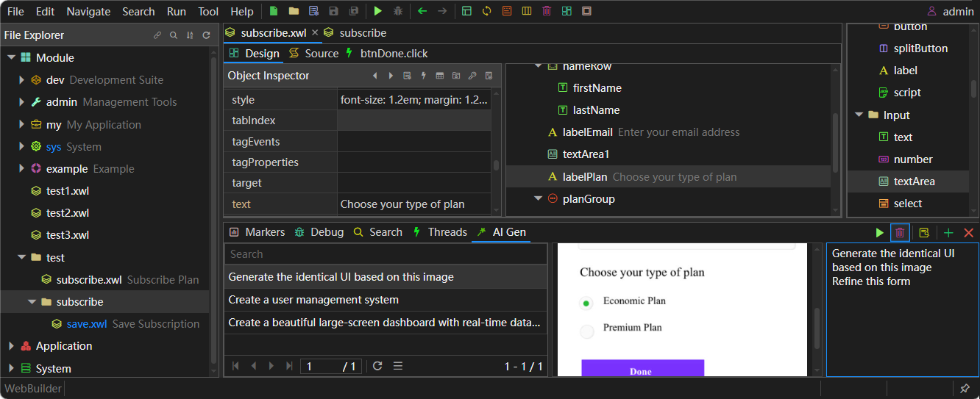
Module 2: AI-Based Module and Code Auto-Generation
WebBuilder is equipped with AI-driven module and code auto-generation capabilities, which can intelligently generate standardized business modules and code content, unify project development specifications, greatly reduce development costs, and improve overall R&D efficiency.
AI-Driven · Intelligent Understanding
Based on natural language understanding technology, it can accurately understand business needs and automatically generate corresponding functional modules, greatly lowering the technical threshold for development.
Standardized Generation · Unified Specifications
Strictly follow the development specifications to generate code and modules, ensuring code quality and maintainability, and making team collaboration more efficient.
R&D Efficiency Improvement · Focus on Innovation
Liberate developers from tedious repetitive coding work, focus on core business logic and innovative thinking, and improve R&D efficiency and quality.
Smart Generation: In the development process, when you encounter repetitive tasks, you can generate the corresponding code and modules with one click, realizing a "worry-free" development experience and greatly improving development efficiency.
Notes:
The second core feature, also a highlight of WebBuilder, is AI-based module and code auto-generation. It can understand your requirements, automatically generate standardized code and modules, which not only unifies development specifications but also frees developers from repetitive work, allowing them to focus on more valuable business innovation.

Slide 14
Module 3: Automatic Adaptation to All Terminal Devices
WebBuilder adopts advanced responsive design technology. Once developed, it can run on all devices, whether it is a desktop browser, mobile phone, Pad, or embedded web pages in WeChat or mini-programs, providing a consistent appearance and easy-to-operate user experience.
Develop Once, Run Anywhere
Consistent User Experience
Broad Device Compatibility
No need to develop separately for different devices, which greatly saves development resources and reduces maintenance costs.
Provide a unified interface style and operation method on different devices, reduce user learning costs, and improve user satisfaction.
Support all mainstream browsers and mobile devices, adapt to different screen sizes and resolutions, and cover the majority of user groups.
Break down device barriers, make your application reach every user anytime and anywhere, and create a seamless digital experience.
Notes:
The third function is automatic adaptation to all terminal devices. Thanks to advanced responsive design technology, you only need to develop once, and the application can run perfectly on various devices such as desktops, mobile phones, tablets, and even WeChat and mini-programs. This not only saves a lot of development resources, but also ensures the consistency of user experience.

Slide 15
03 Core Function Details
AI Intelligent Generation Engine
Multi-Terminal Adaptive Layout
Performance Intelligent Optimization
Based on deep learning algorithms, it can automatically generate complete application modules according to business needs, quickly build system prototypes, and shorten the development cycle.
Automatically adjust the page layout and element size according to the device screen, ensuring a consistent and excellent visual experience and interaction under different screen resolutions.
Automatically analyze code and resource loading, optimize rendering performance and response speed, ensure the stable and efficient operation of the application, and optimize the user experience.
WebBuilder's AI core capabilities have broken the efficiency bottleneck of traditional development, and the intelligent technology empowers every developer, making application development simpler, more efficient and more autonomous.
Notes:
After learning about the main features of WebBuilder, let's now delve into its core and analyze in detail WebBuilder's powerful AI capabilities to see how it subverts traditional development models.

Slide 16
AI-Driven Development Paradigm
Natural Language Interaction
Developers describe business needs through natural language, and AI can accurately understand and automatically convert them into specific application functions, greatly lowering the development technical threshold.
Intelligent Code Generation
Based on demand, it automatically generates high-quality and maintainable code, covering front-end interfaces, back-end logic and database operations, significantly improving development efficiency.
WebBuilder has reshaped the underlying logic of software development, transforming the traditional "coding implementation" into "intention-driven". The development process is more like an efficient dialogue of collaborative creation with AI, providing an extreme engine for enterprise digital transformation.
Self-Learning and Optimization
The AI model continuously learns the user's development habits and project patterns, and as the usage deepens, the output results will be more accurate and personalized.
Notes:
WebBuilder's AI capabilities bring a new development paradigm. You can tell the AI what you want in natural language, and it can understand and generate the corresponding functions and code. Even smarter, this AI model can keep learning and optimizing to provide you with increasingly accurate personalized services.

Slide 17
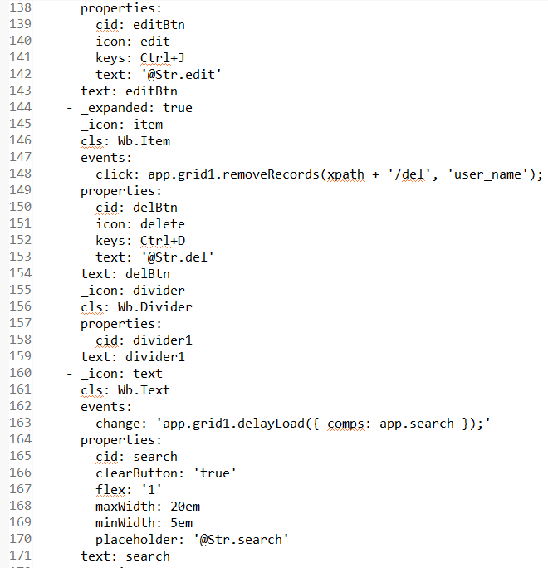
XWL: The Core Technical Architecture of WebBuilder
Declarative Programming: Focus on the Goal, Not the Process
Developers only need to describe "what to do", and XWL defines the structure, components and behavior of the application, while AI is responsible for converting it into specific code, which greatly simplifies the development process.
High Readability: Clear Structure, Efficient Collaboration
The YAML format is concise and clear, making the application structure clear at a glance, which is conducive to team collaboration and later maintenance, and greatly reduces the team's communication cost.
High Scalability: Flexibly Adapt to Business Needs
New functions can be easily added or modified by simply modifying or extending the XWL file without going deep into the underlying code, quickly responding to business changes.
The powerful capabilities of WebBuilder stem from its unique XWL technical architecture, realizing "what you see is what you get" in the design process.
Notes:
Behind all these powerful capabilities is WebBuilder's unique XWL technical architecture. XWL is a declarative language that allows developers to focus only on "what to do", leaving the complex work of "how to do it" to AI. This approach not only makes the code more readable and maintainable, but also gives the system extremely high scalability.

Slide 18
How AI Achieves Efficient Development
01 Requirement Understanding
02 Module Generation
03 Code Conversion
04 Optimization and Verification
Deeply parse natural language descriptions or XWL definitions, accurately grasp business logic and functional requirements, and lay a solid foundation for development.
Based on the automatically identified requirements, select appropriate components and templates from the knowledge base to generate standardized XWL modules, ensuring the rationality of the structure.
Compile the generated XWL modules into efficient front-end and back-end code, realizing the real transformation from design to development, and ensuring the correctness and performance of the code.
Intelligently optimize the generated code, automatically complete basic verification and testing, ensure the stability and reliability of the code, and reduce manual testing costs.
The full-link automated process raises development efficiency to a new height, allowing developers to focus on value creation.
Notes:
So, how exactly does AI work? The entire process is clear and efficient: First, AI understands your requirements; then, it generates the corresponding XWL modules; next, it compiles the modules into efficient front-end and back-end code; finally, it performs optimization and verification. This automated process has raised development efficiency to a whole new level.

Slide 19
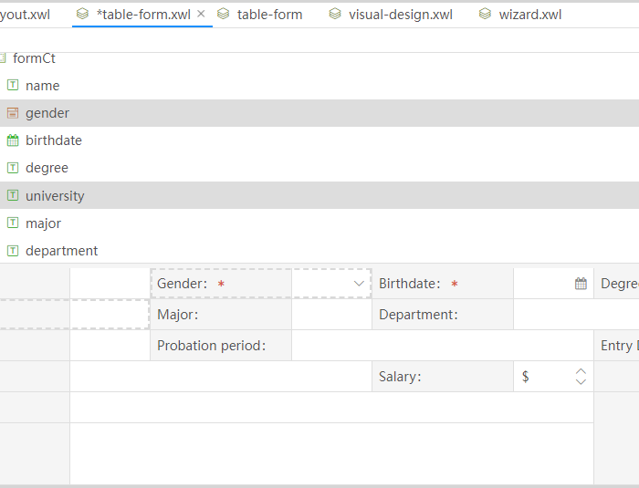
Core Function: Visual Designer
WebBuilder's visual designer breaks the traditional development model, providing an intuitive and interactive way to build efficient application interfaces, making design and construction fully integrated.
WYSIWYG Experience
Responsive Elastic Layout
Design operations are fed back in real-time, with no need to switch previews frequently. The visual design mode makes the development process more intuitive and reduces trial and error costs.
Automatically adapt to different screen sizes and resolutions, with flexible layout containers that ensure the best display effect on any device.
Highly Flexible Design
Cross-Terminal Automatic Adaptation
Supports designing arbitrarily complex enterprise-level application interfaces, and can easily replicate the styles and interaction logic of mainstream Apps to meet personalized needs.
One design automatically adapts to desktops, mobile phones, Pads, WeChat and mini-programs, saving development costs.
Visual Designer Interface Preview: Drag and drop to complete complex layouts intuitively
Notes:
WebBuilder's visual designer is one of its core advantages. It adopts a WYSIWYG design mode, allowing you to see the final effect while designing. The powerful responsive layout engine automatically adapts to various devices, enabling easy design of even the most complex interfaces, and a single design runs perfectly on all terminals.

Slide 20
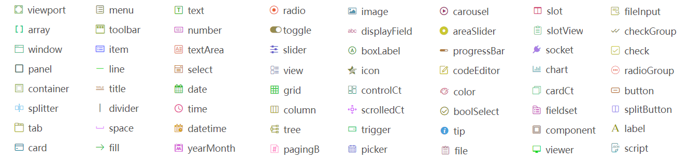
Core Function: Rich Component Library
WebBuilder provides an industry-leading, comprehensive and high-quality component library, covering all needs from basic UI to complex interactions, allowing developers to quickly build applications like building blocks.
Basic Layout Containers
Input and Selection
Data Visualization
Interaction and Feedback
Including viewpoint, window, panel, tab, card, etc., providing a solid foundation for page layout.
Including text, select, radio, date, file and other common form elements to meet diverse data input needs.
Including grid, tree, chart and other components, supporting rich data display and statistical analysis.
Including button, tip, progressBar and other components to enhance user interaction experience and operational feedback.
Open and Easy to Use, Rapid Construction
With rich and open components, it meets the development needs of complex enterprise applications. Whether it is front-end display or back-end interaction, it can be quickly implemented, allowing developers to focus on core business logic.
Notes:
To support efficient development, WebBuilder offers an extremely rich component library. From basic layout containers and input selection components to complex data display and charts, and various interactive feedback components, it covers almost all the needs of enterprise-level application development, allowing you to quickly build applications like building blocks.

Slide 21
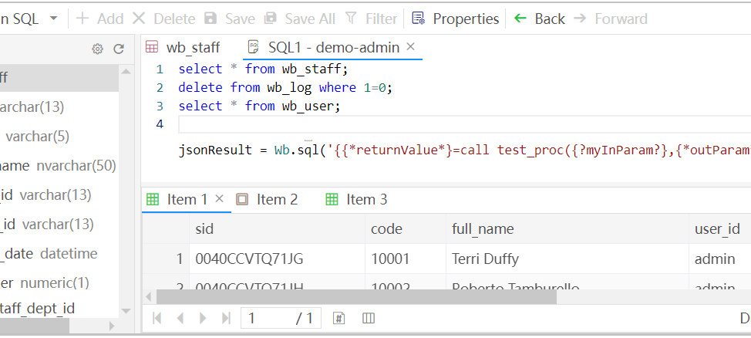
Core Function: One-Click Publish & Data Source Management
One-Click Publish: Rapid Deployment
One-click generation of release packages, upload to the server and run directly, eliminating complex configuration processes. The automated process shortens the online time by more than 50% and improves R&D efficiency.
Data Source Management: Efficient Connection
The built-in visual database management console provides intuitive query, editing and stored procedure debugging capabilities. Whether it is rapid verification in the development phase or data monitoring in the operation and maintenance phase, it can be efficiently completed through a concise interface, greatly reducing the technical threshold.
The built-in visual data management tool has a concise interface, supports drag-and-drop configuration, and connects to mainstream databases like MySQL, Oracle, SQL Server easily.
Notes:
WebBuilder greatly simplifies application deployment and data operations. With the one-click publish feature, you can easily deploy applications to servers. It also provides a minimalist data source management API, allowing you to operate databases without writing complex SQL statements. The system automatically manages database connections, letting you focus more on business logic.

Slide 22
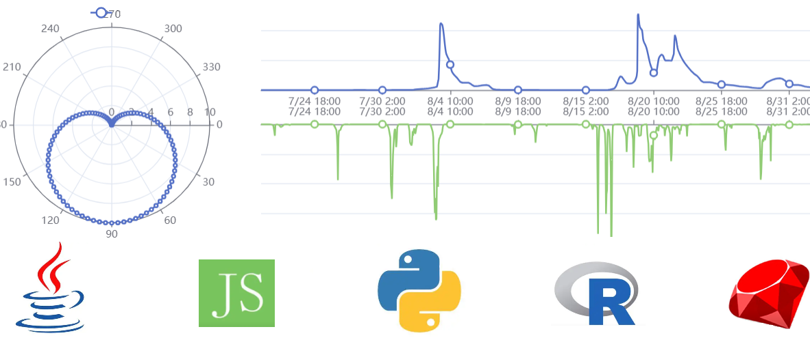
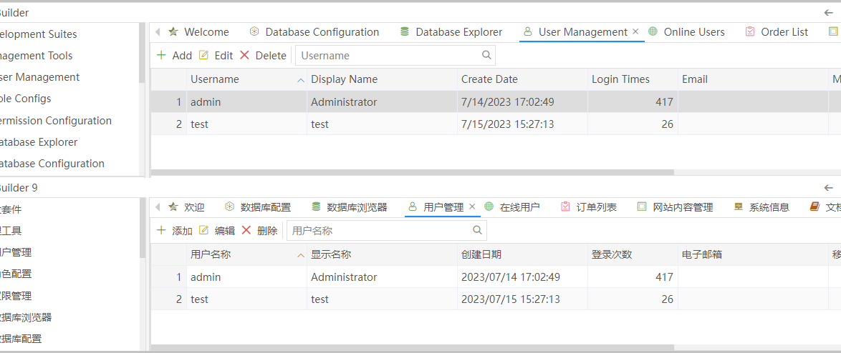
Core Function: Multi-Language Support & Internationalization
01 Flexible Multi-Language Development
02 Intelligent Global Adaptation Capability
Supporting multiple programming languages such as Java, Python, JS, R, Ruby, breaking technical barriers. Developers can choose the most suitable language based on the team's technical stack, improving development flexibility and efficiency, and making technical selection no longer a constraint.
Built-in internationalization support automatically adapts to language, date, and number formats based on the client's region, enabling a friendly interface and smooth global release.
Notes:
WebBuilder has powerful global development capabilities. It supports multiple programming languages such as Java and Python, giving developers full freedom in technical selection. Meanwhile, the built-in internationalization support allows your application to easily adapt to user habits in different countries and regions, automatically switching languages, dates, and number formats.

Slide 23
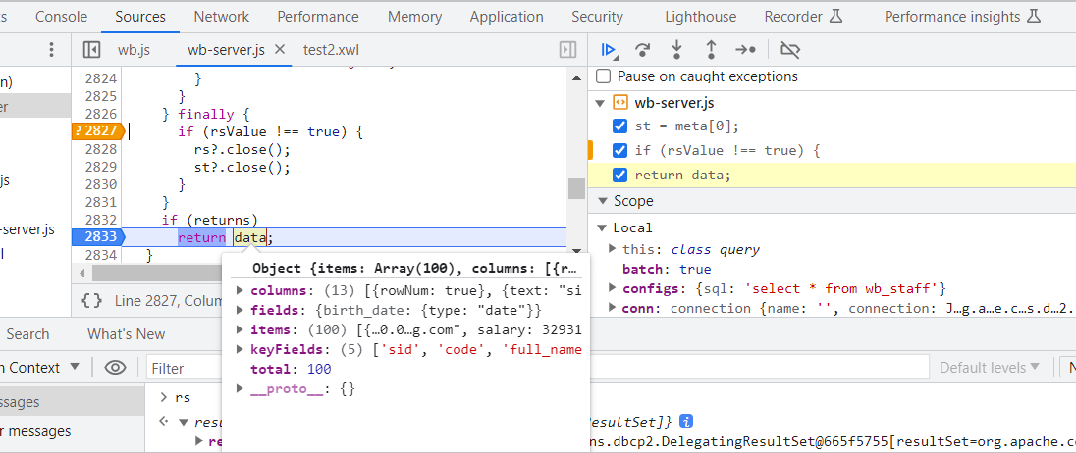
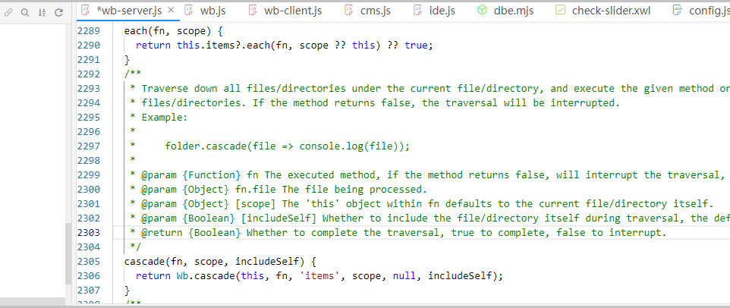
Core Function: Team Collaboration & Intelligent Development
Multi-User Concurrent Debugging
Intelligent Editor Core
Automated Document Synchronization
Supporting multiple developers to perform concurrent remote debugging online at the same time, using browser DevTools for remote debugging of server-side code, with the same experience as local development, facilitating real-time collaboration within the team.
Based on the same Monaco engine as VS Code, it provides intelligent prompt, syntax highlighting, code completion and other functions, improving coding efficiency and accuracy.
Built-in document reader, with a wealth of content. It supports one-click automatic generation of project documents from source code, ensuring that documents and code are updated synchronously, saving time and reducing costs.
Notes:
To enhance team collaboration efficiency, WebBuilder supports multi-user concurrent remote debugging, enabling seamless teamwork among team members. Its code editor is based on the powerful Monaco engine, offering features like intelligent prompts to make coding more efficient. Additionally, the robust documentation support ensures that your project documents are always in sync with the code.

Slide 24
04 Competitive Analysis
WebBuilder
WorkBuddy
bolt AI
WebBuilder: Intelligent generation, multi-terminal adaptation, built-in security, and strong complex business processing capabilities, deeply supporting the construction of enterprise-level applications.
WorkBuddy: Focuses on team collaboration and office efficiency, with standardized templates and processes, but has weak AI generation capabilities and relatively limited adaptability to complex scenarios.
bolt AI: Focuses on code generation assistance, with high learning costs, the generated results are not stable enough, and it lacks support for complex business logic and system-level functions, with insufficient optimization in terms of iteration and evolution.
WebBuilder's breakthrough in visual interaction and deep AI integration has achieved a leapfrog improvement in ease of use and functional depth, truly making enterprise-level application construction as simple as building blocks.
Notes:
No matter how much theory is said, it's better to compare in practice. Next, we will conduct a detailed comparison between WebBuilder and well-known AI tools WorkBuddy and bolt AI on the market to see where WebBuilder is really strong.

Slide 25
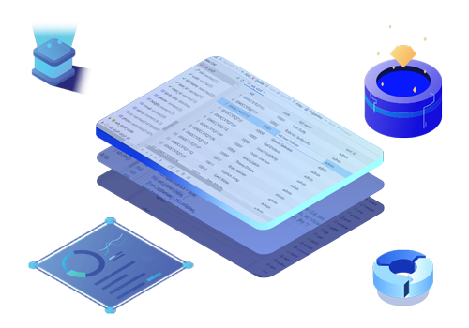
Token Usage Efficiency
Token usage is directly related to the operating cost of AI applications. WebBuilder has significant advantages in this regard through architectural optimization, starting from the source to save costs and providing enterprises with a high-cost-performance AI application development experience.
XWL Architecture: Structured Instructions for Precise Cost Reduction
Through the unique XWL tree structure, it provides structured instructions for AI, reducing the redundant Token loss caused by semantic understanding, allowing the model to accurately grasp the core intent and avoid invalid calculations.
Intelligence: Full-Link Deep Regulation
On the premise of ensuring the accuracy of the model, the average Token consumption is reduced, maximizing the Token utilization rate and ensuring cost-effectiveness.
Achieve more with less cost, maximize the value of AI applications, and realize substantial cost savings.
Notes:
First, let's look at Token Usage Efficiency, which is directly tied to an enterprise's operational costs. WebBuilder leverages its unique XWL architecture to enable AI to understand instructions more precisely, thereby significantly reducing Token consumption. This means achieving more with less cost.

Slide 26


Token Usage Efficiency Comparison
WebBuilder
Efficiency: Very High
WorkBuddy
bolt AI
Based on the self-developed platform and XWL architecture, the AI model has been deeply optimized to complete more complex tasks with fewer Tokens. Internal mechanisms reduce unnecessary model calls and data transmission, ultimately reducing development costs.
Efficiency: Medium
Efficiency: Medium
As a general AI office assistant, its Token consumption is related to specific tasks and the called model, lacking in-depth optimization for application development scenarios.
As a code generation tool, its Token consumption depends on the length and complexity of the generated code, and usually requires more Tokens to generate a complete application.
Notes:
It is clear from the comparison that WebBuilder has a 'Very High' Token usage efficiency, while WorkBuddy and bolt AI are at a 'Medium' level. This is due to WebBuilder's architecture, which is deeply optimized for application development scenarios, enabling it to complete more complex tasks with fewer Tokens.

Slide 27
Comparison Dimension 2: Accuracy of AI-Generated Applications
The accuracy of generated applications directly determines the workload of subsequent development and debugging. WebBuilder performs excellently in understanding complex business logic, realizing a leap from "rough generation" to "accurate creation", making AI truly a powerful engine for enterprise development.
Deep Adaptation to Enterprise Scenarios
Driven by XWL Structured Definition
Accuracy Far Exceeds General AI
The AI model is specially optimized for enterprise-level application development, deeply understanding complex business processes and data models, ensuring the accuracy of generated applications.
Combined with the structured definition of XWL, the generated applications are far superior to general AI tools in terms of functional integrity and business logic accuracy.
The powerful logical reasoning ability of WebBuilder's AI can accurately identify and implement complex business rules, greatly reducing manual modification and debugging costs.
Core Value: Evolve from "generating interfaces" to "generating businesses", realizing a one-step process from prototype design to usable systems, making AI generation a truly efficient engine for enterprise application development.
Notes:
The second comparison dimension is the accuracy of AI-generated applications. General AI tools may be good at generating simple interfaces, but they struggle with complex enterprise-level business logic. WebBuilder's AI is specially optimized to deeply understand business processes, resulting in more accurate generated applications and greatly reducing the workload of later modifications.

Slide 28
Accuracy Comparison of AI-Generated Applications
WebBuilder
WorkBuddy
bolt AI
Accuracy: Very High ⭐⭐⭐⭐⭐
Accuracy: Medium ⭐⭐⭐
Accuracy: Medium ⭐⭐⭐
Trained based on XWL architecture and a rich knowledge base of enterprise-level application development, it can deeply understand complex business logic and data relationships, and the generated applications are highly consistent with user requirements.
Mainly oriented towards office automation scenarios, its understanding and generation capabilities are relatively limited for complex application development needs, and may require a lot of manual adjustments.
Good at generating front-end interfaces and basic functions, but for complex business logic and data processing, the generated code may not be perfect and requires a lot of modification by developers.
Notes:
Data shows that WebBuilder's AI generation accuracy is "Very High" as it is trained on a rich knowledge base of enterprise applications. In contrast, WorkBuddy and bolt AI are more geared towards general scenarios, with limited accuracy in handling complex business needs, requiring significant manual adjustments.

Slide 29
Comparison Dimension 3: Security and Permission Issues
Enterprise-level applications have extremely high requirements for security, not only ensuring the confidentiality and integrity of data, but also strictly controlling user access rights. WebBuilder deeply integrates enterprise-level security architecture, with a built-in complete security system, providing all-round security guarantees from the architecture to the application layer.
End-to-End Security Protection
Fine-Grained Permission Control
Out-of-the-Box Security Mechanism
From identity authentication to data encryption, multi-dimensional security protection is provided at all levels to ensure the security of data and business.
Supporting multi-level and multi-dimensional permission configuration, flexible allocation of different operation rights according to roles, meeting the complex permission management needs of enterprises.
Developers do not need to care about underlying security implementation, and the platform provides a complete security mechanism out of the box, greatly reducing security risks and costs.
Security is not only a function, but also the cornerstone of enterprise digital transformation - WebBuilder makes development more secure and reliable.
Notes:
Security is the lifeline of enterprises. As an enterprise‑grade platform, WebBuilder comes with a comprehensive built‑in security and permission management system. This means developers no longer need to worry about complex permission controls, as the platform delivers end‑to‑end security protection for you.

Slide 30
Security and Permission Issue Comparison
WebBuilder
WorkBuddy
bolt AI
✅ Built-in complete enterprise-level security system
⚠️ Relies on third-party integration
⚠️ Relies on basic environment control
As an enterprise-level platform, it has a comprehensive security permission management system built-in, supporting fine-grained user roles and permission control to ensure data security.
Its own security permission functions are weak, and it usually needs to rely on integration with other office software (such as Tencent Docs, WeChat Work) to achieve permission management.
It only provides basic project access permission control, lacking complex permission management functions required for enterprise-level applications, such as data isolation and operation auditing.
Conclusion: WebBuilder has the most significant advantage in the security permission dimension, and is the best choice for building secure enterprise-level applications.
Notes:
In terms of security and permissions, WebBuilder has an overwhelming advantage. It has a complete built-in enterprise-level permission management system. In contrast, WorkBuddy needs to rely on integration with other software, and bolt AI only provides basic permissions, neither of which can meet the security requirements of complex enterprise applications.

Slide 31
Comparison Dimension 4: Resource Management and Release
Underlying resource management is the key to ensuring the stable operation of applications. In traditional development modes, developers spend a lot of energy on server resource configuration, memory allocation and release and other underlying details, while WebBuilder has realized full-link intelligent automatic management, liberating developers from complex resource management.
One-Stop Development Environment
Intelligent Resource Scheduling
Ultimate Stability Guarantee
Integrated development, testing and runtime environment, no need to configure complex server environments, one-click deployment, reducing the difficulty of operation and maintenance.
Automatically manage the allocation and release of server resources according to the load, ensuring the stability and high-efficiency operation of the application, and improving resource utilization.
The automated resource management mechanism can effectively avoid memory leaks and resource waste under high concurrency, ensuring the stable operation of the application for a long time.
Notes:
Fourth, let's look at resource management. Developers usually don't want to be bothered by underlying issues such as server resource allocation and memory release. WebBuilder provides a one-stop environment that automatically manages all resources, allowing developers to focus entirely on implementing business logic.

Slide 32
Resource Management and Release Comparison
WebBuilder
Automatic Management
WorkBuddy
bolt AI
WebBuilder's runtime environment automatically manages the allocation and release of server resources. Developers do not need to care about underlying resource management, avoiding memory leaks and resource waste.
Partially Automatic
Manual Management
As a desktop application, its resource management mainly relies on the operating system, but when processing large-scale data or complex tasks, user manual intervention may be required to release resources.
The generated applications usually need to be deployed to third-party servers, and resource management and release require developers to configure and maintain by themselves, increasing operational complexity.
Notes:
From the comparison, WebBuilder is the only platform that achieves "Automatic Management" of resources. WorkBuddy relies on the operating system, while bolt AI requires manual management by developers, which undoubtedly increases the complexity and potential risks of operation and maintenance.

Slide 33
Comparison Dimension 5: Quality and Maintainability of Generated Code
Code quality directly affects the life cycle and maintenance cost of a project. WebBuilder perfectly inherits the advantages of the XWL architecture, generating clean, standardized and unified engineering code, fundamentally reducing the maintenance cost of later generations.
XWL Architecture Guarantee
Flexible Expansion & Customization
Full Lifecycle Efficiency
Supporting secondary development and customized expansion on the basis of generated code without destroying the stability of the underlying system, meeting personalized needs.
The well-designed architecture and standardized code ensure the maintainability and scalability of the system in the long run, reducing development and maintenance costs.
Based on the standardized XWL structure, the generated code has a clear hierarchy and standardized style, which is convenient for manual modification and debugging by developers, and has strong engineering practicability.
Building a modern code system that is easy to read, extend and maintain, providing a solid guarantee for the sustainable growth and long-term evolution of the project.
Notes:
The fifth dimension is code quality and maintainability. The long-term value of a project largely depends on its code quality. WebBuilder generates code with a clear structure, standardized uniformity, and high modularity, making it very easy to understand, modify, and extend.

Slide 34
Quality and Maintainability Comparison of Generated Code
WebBuilder
WorkBuddy
bolt AI
Concise & Highly Maintainable
General-Purpose Code
Verbose & Poor Maintainability
The code generated based on XWL has a clear structure and unified specifications, following best practices. The code is highly modular, easy to understand, modify and expand.
The generated code is mainly used for office automation scripts, with a relatively simple structure and average maintainability, not suitable for building complex enterprise-level applications.
The generated code often contains a lot of redundant parts and the structure is not clear enough. For complex projects, later maintenance and expansion are difficult.
Notes:
The table clearly shows the differences. The code generated by WebBuilder is "concise and highly maintainable". In contrast, the code from WorkBuddy is general-purpose but not suitable for complex projects, while the code generated by bolt AI is often verbose and difficult to maintain.

Slide 35
Comparison Dimension 6: AI Learning Example Supplement
Whether AI's capabilities can continue to evolve and adapt to specific businesses is crucial. WebBuilder has broken the static limitations of traditional models through open learning mechanisms, allowing artificial intelligence to truly learn the enterprise's business knowledge and become a dynamic intelligent assistant for business growth.
Open Evolution Engine
Business Asset Modularization
Customization Barrier
Breaking closed restrictions, supporting the absorption of enterprise-specific business knowledge and code templates, enabling the AI model to continuously evolve and grow with the development of the enterprise.
Enterprises can encapsulate their own best practices and business knowledge into modules, let AI learn and apply them to new projects, forming a unique competitive advantage.
Based on the customized training of enterprise-specific knowledge, it can generate solutions that are more in line with the business characteristics of the enterprise, building a core technical barrier.
Core value: Transform from a general tool to an enterprise-specific "big butler", realizing a qualitative leap from tool empowerment to ecological empowerment, and providing an inexhaustible driving force for enterprise development.
Notes:
The final comparison dimension is the supplementary capability of AI learning examples. A good AI tool should be evolvable. WebBuilder allows users to easily add custom modules as AI learning examples, enabling the AI to quickly adapt to the business needs of specific industries or enterprises and form a unique competitive advantage.

Slide 36
AI Learning Example Supplement Comparison
WebBuilder
WorkBuddy
bolt AI
Convenient & Flexible
Limited
Difficult & Fixed Model
Users can conveniently supplement custom module files (XWL format) as examples for AI learning, enabling AI to quickly adapt to the business needs of specific industries or enterprises.
Mainly relies on the skills and templates built into the platform, and users have very limited ways to customize and expand AI capabilities.
The AI model is relatively fixed, and it is difficult for users to teach AI new knowledge or patterns in a simple way, with weak customization capabilities.
Core value: High flexibility and scalability.
Notes:
In this regard, WebBuilder also has a clear advantage. Its AI learning example supplementation is 'convenient and flexible'. In contrast, WorkBuddy has limited scalability, and bolt AI almost does not allow users to customize the AI's learning content. This enables WebBuilder to truly become an enterprise-exclusive, continuously evolving AI development assistant.

Slide 37
05 Case Studies
WebBuilder has landed successfully in many industries with its powerful functions and scalable capabilities, helping enterprises build stable and efficient digital solutions and achieve sustainable business growth.
Retail E-commerce · Omni-channel Growth
Intelligent Manufacturing · Production Line Upgrade
Smart Finance · Safe and Efficient
Building a full-link digital system, connecting online and offline business scenarios, realizing refined operation and management of users, and achieving sustainable growth in performance.
Building an intelligent management system, connecting production, supply and marketing data, optimizing production processes, improving production efficiency and quality, and promoting intelligent upgrading of enterprises.
Building a risk control and management system, realizing real-time monitoring and analysis of financial data, ensuring the security and stability of funds, and helping financial institutions improve service quality and user experience.
From traditional business to digital transformation, WebBuilder continues to empower thousands of industries, laying a solid digital foundation for reliable development.
Notes:
Theory and comparisons have proven WebBuilder's power. Next, let's look at its performance in practical applications. WebBuilder has been successfully implemented in multiple industries, helping enterprises achieve digital transformation.

Slide 38

Finance Industry Case
A large commercial bank introduced the WebBuilder low-code platform to quickly build a risk management system, realizing real-time collection, monitoring, early warning and intelligent analysis of risk data, effectively improving risk identification and disposal efficiency, and escorting the safe operation of business.
60% Development Cycle Reduction
Millisecond-level Real-time Monitoring
80%
Millisecond-level
The original project with a cycle of 6 months was shortened to 2 months, greatly reducing development costs.
Real-time monitoring and analysis of massive data, timely warning of risks, and ensuring the safety of funds.
Digital transformation technology empowers, the bank has successfully realized a leap from traditional development to agile development, and is at the forefront of the digital transformation of the financial industry.
Notes:
In the finance industry, a large commercial bank used WebBuilder to develop a risk management system. By monitoring and analyzing risk data in real time, they not only improved their risk control capabilities but also reduced the development cycle by an astonishing 80%.

Slide 39
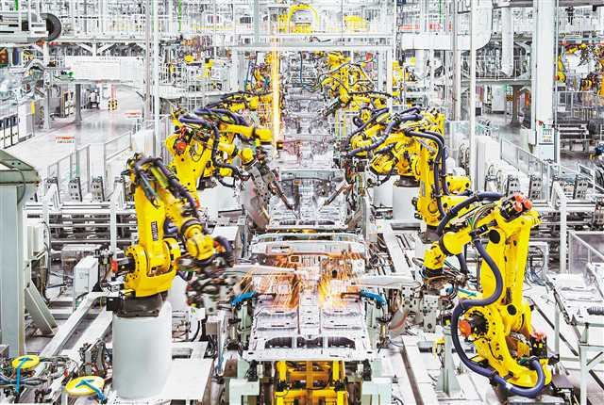
Manufacturing Industry Case
A well-known automobile manufacturer introduced the WebBuilder low-code platform to build an integrated supply chain management system, realizing the full-process digitalization of material procurement, vehicle management and finished product distribution, breaking the information island of the traditional supply chain, realizing real-time data interaction, and significantly improving the speed of decision-making response and resource utilization.
45% Operating Cost Reduction
Optimizing the supply chain process, reducing intermediate links and resource waste, and effectively reducing operating costs.
Production Efficiency UP
Improving production scheduling and resource allocation capabilities, and significantly increasing production efficiency.
Notes:
In the manufacturing industry, an automobile manufacturer built a supply chain management system through WebBuilder. This system optimized the entire production process and ultimately helped the company reduce operating costs by 45%.

Slide 40

Retail Industry Case
Implementation of Intelligent Membership Management and Marketing System
A well-known retail enterprise built a digital membership system through the WebBuilder low-code platform, realizing the digitalization of member management, the automation of marketing activities, and the intelligent transformation of user operations.
Member Digitalize
Marketing Automation
Business Growth
Automatically triggering marketing activities according to user behavior, improving conversion rates and user stickiness.
Improving user experience and repurchase rate through refined operation, achieving sustainable business growth.
Realizing the full life cycle management of members, accurately portraying user portraits, and providing personalized services.
Empowering digital transformation, building a new integrated retail ecosystem, and maximizing the value of customers.
Notes:
In the retail industry, a chain enterprise used WebBuilder to develop a membership management and marketing system, effectively improving customer experience and repurchase rate, and achieving business growth.

Slide 41

Medical Industry Case
Digital Medical Record Storage
Realizing the paperless storage of medical records, real-time synchronization and sharing, ensuring the security and privacy of medical records.
Millisecond-level Intelligent Retrieval
Supporting multi-dimensional query and statistical analysis of medical records, quickly locating key information, reducing the time for doctors to search for information, and improving the efficiency of diagnosis and treatment.
Based on the WebBuilder rapid construction platform, the electronic medical record management system has been successfully built, effectively improving the digital management level of the hospital, optimizing medical service processes, and improving the quality of medical services.
Service Process Efficiency Improvement
Optimizing the medical process, reducing the waiting time of patients, allowing medical staff to focus more on diagnosis and treatment, and comprehensively improving the efficiency of medical services and patient satisfaction.
Notes:
In the medical industry, a hospital developed an electronic medical record management system through WebBuilder, realizing the digitization and efficient retrieval of medical records, and significantly improving the quality and efficiency of medical services.

Slide 42
06 Our Clients
Trustworthy partners, working together to create a digital future
Industry Leading Enterprises
Technology Innovation Partners
Growing Enterprises
Serving thousands of well-known enterprises, focusing on solving the pain points of complex business scenarios, providing reliable and stable solutions, and helping enterprises achieve sustainable development.
Growing together with enterprises, providing cutting-edge technical support, helping to realize digital transformation and industrial upgrading, and empowering technological breakthroughs and industrial upgrading.
Providing flexible and scalable solutions to meet the personalized needs of enterprises at different development stages, and helping enterprises achieve rapid growth.
500+ enterprises have joined the Geejing ecosystem, covering more than 20 core industries
98% customer satisfaction, adhering to the concept of technological empowerment and supporting partners
Notes:
WebBuilder's superior performance and high-quality service have won the trust of many well-known enterprises. Next, let's see which industry leaders have chosen us.

Slide 43
07 Summary and Outlook
Opening a New Chapter in Application Development
Milestone Review
Steady Progress
Future Outlook
From the initial research and development to the continuous iteration of the product, we have always adhered to the user-centric principle, created a high-performance, high-reliability technical architecture, and strived to create greater value for customers.
Continuously optimizing product performance, deeply integrating the core AI engine, improving development efficiency, and building a safer, more stable and efficient development tool to help enterprises develop rapidly.
Continuing to innovate and research, enriching multi-scenario application templates, enhancing iteration capabilities, building an open developer ecosystem, and empowering thousands of industries to achieve digital transformation.
Empowered by technology, driven by innovation, hand in hand to create an unlimited future for application development.
Notes:
Finally, let's summarize today's sharing and look forward to the future of WebBuilder.

Slide 44
Summary
As a revolutionary enterprise-level application development platform, WebBuilder provides an efficient, low-cost, and high-quality application development solution for enterprises through the deep integration of AI technology and the innovative XWL architecture. Compared with general AI tools, it has achieved a comprehensive breakthrough in development efficiency, matching accuracy and security, becoming the core engine for enterprise digital transformation.
Ultimate Token Efficiency
High Generation Accuracy
Enterprise-Grade Security Guarantee
Effectively reducing Token consumption, greatly lowering AI usage costs, and providing enterprises with a more cost-effective development experience.
Based on industry-specific knowledge reserves and deep understanding of business logic, the generated applications are highly consistent with actual business scenarios, reducing manual modification costs.
Built-in complete security mechanism and fine-grained permission control, strictly guaranteeing data security at all levels, and escorting enterprise core business.
Intelligent Resource Management
Advanced Code Quality
Highly Flexible Customization
Automatically managing underlying resources such as server allocation and release, avoiding resource waste and memory leaks, and maximizing resource utilization.
Generating standardized and clean code, ensuring the maintainability and scalability of the system, and reducing long-term maintenance costs.
Supporting personalized development and secondary expansion to meet the unique business needs of enterprises and quickly respond to market changes.
Notes:
In summary, WebBuilder, through the deep integration of AI and the XWL architecture, offers an efficient, low-cost, and high-quality development solution. Compared with general AI tools, it has significant advantages in six key dimensions: Token efficiency, generation accuracy, security, resource management, code quality, and customizability.

Slide 45
Outlook
Deepen AI Capabilities
Expand Industry Solutions
Strengthen Ecological Construction
Introducing more advanced AI models to further improve the accuracy of natural language understanding and code generation, and make AI smarter and more in line with business needs.
Providing pre-built solutions and templates for more industries such as finance and education, helping enterprises achieve digital transformation faster and reducing development costs.
Opening up platform API interfaces, encouraging third-party developers to develop plug-ins and components for WebBuilder, and building an open and shared technology ecosystem.
In the future, we will continue to keep up with the forefront of technology. WebBuilder will become the core engine of enterprise digital transformation and build a prosperous developer ecosystem.
Notes:
Outlook: In the future, we will continue to deepen AI capabilities, expand industry solutions, and strengthen ecological construction. Our goal is to make WebBuilder smarter and easier to use, and build a prosperous developer ecosystem.

Slide 46

Thank You
Making Informatization Construction Simple and Beautiful
Join Hands · Intelligent Future | https://www.geejing.com | contact@geejing.com
Notes:
We believe that WebBuilder will continue to lead the AI-driven application development trend, making informatization construction simpler and more beautiful. That's the end of my sharing. Thank you all for listening!

